Slide 1
Computer Vision 101 - Gluon CV

Slide 2
Computer Vision Architectures

Slide 3

LeNet 1995
Multiple convolutions blow up dimensionality
Subsampling - average over patches (works OK)
MaxPooling - pick the maximum over patches (much better)

Slide 4
AlexNet (Krizhevsky et al., 2012)
More convolutional layers
More channels
More filters
More data
More computation

Slide 5
Deep and Narrow or Wide and Shallow
+
vs.
Want to reach receptive field of size k
Use one large filter (linear mix of many, then nonlinearity)
Use several small filters (many linear mixes of few) - has fewer parameters
Simonyan & Zisserman, 2014 find that deep and narrow wins

Slide 6
Fancy structures - Networks of networks
Compute different filters
Compose one big vector from all of them
Layer them iteratively
Szegedy et al. arxiv.org/pdf/1409.4842v1.pdf

Slide 7
Batch Norm (Ioffe et al., 2015)
loss
Loss occurs at last layer
Last layers learn quickly
Data is inserted at bottom layer
Bottom layers change - everything changes
Last layers need to relearn many times
Slow convergence
This is like covariate shift Can we avoid changing last layers while learning first layers?
data

Slide 8
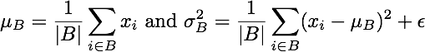
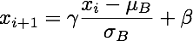
Batch Norm (Ioffe et al., 2015)
loss
Can we avoid changing last layers while learning first layers?
Fix mean and variance and adjust it separately
mean
variance
data

Slide 9
ResNet (He et al., 2015)
In regular layer simple function is given by f(x) = 0
Key idea - ‘Taylor expansion’

Slide 10
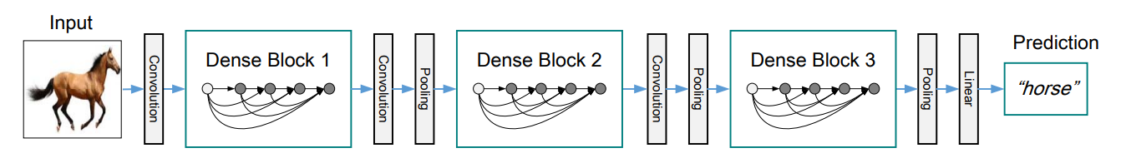
DenseNet (Huang et al., 2016)
Simple Network
In ResNet ‘Taylor expansion’ ends after one term
In DenseNet use multiple steps

Slide 11
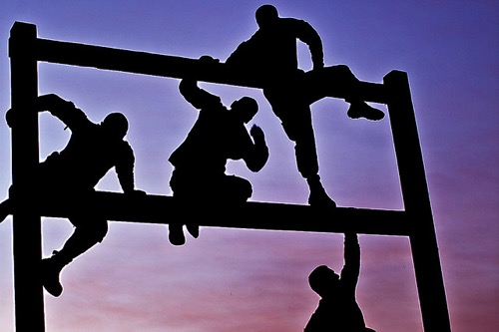
Why GluonCV?
What is the biggest challenge you have ever encountered with deep learning?

Slide 12
Why GluonCV?
What is the biggest challenge you have ever encountered with deep learning?
“reproducing the best claimed results”

Slide 13
Real-world Stories
Back to a period in 2016, the same ImageNet models trained by MXNet achieves on average 1% worse accuracy compared to Torch.
Tried almost everything to debug, even developed a plugin to run Torch code inside MXNet so that it is easier to compare the results.
Transcoding training images using 95 JPEG quality rather than 85 solved the problem.

Slide 14
Real-world Stories
Using another open source DL framework, a similar problem happened: trained model accuracies cannot match previous internal version.
Spent months to figure out why, with no clue.
The order of data augmentation is different from previous version.

Slide 15
Starting from scratch can be hard
Even the most talented researchers will get blocked by trivial things.
Experiences and instincts might be your enemies in certain circumstances.
Training is time-consuming, initialization and augmentation is randomized, and tons of implementation details need to be taken care of. Debugging deep models is extremely difficult.

Slide 16
It’s not easy to embrace open-source implementations
Qualities of open-source implementations vary.
Languages, code styles, project structures, DL frameworks are mixed.
Personal projects tend to focusing on a specific task with specific datasets. It requires significant engineering efforts to adapt to your use case.
Community projects can be abandoned frequently.

Slide 17


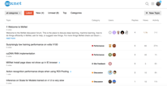
What does GluonCV provide
Reproduction of important papers in recent years
Training scripts (as well as tuned hyper-parameters) to reproduce the results
Considerate APIs and modules that are easy to follow and understand, so that re-invent based on existing algorithms are less frustrating
Community support, feel free to ask and discuss

Slide 18
Enough talk, show me something!
Demo notebook

Slide 19
What’s in GluonCV
Image Classification
More than 20+ pre-trained ImageNet models(ResNet, MobileNet…)
We achieved the best accuracy using some of the most popular models(e.g., ResNet), compared with other frameworks

Slide 20
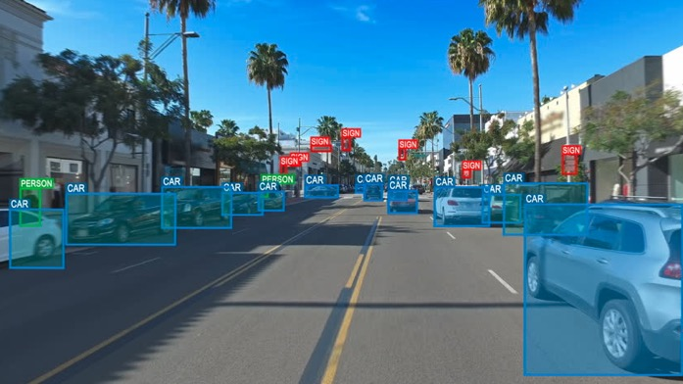
What’s in GluonCV
Object Detection
SSD and YOLOv3: fastest solution
Faster-RCNN, RFCN and FPN: slower but more accurate, especially for tiny objects
Mask-RCNN: simultaneous object detection and semantic segmentation

Slide 21
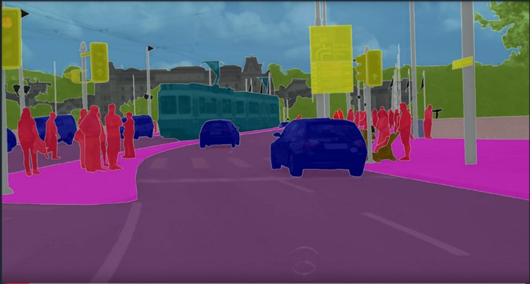
What’s in GluonCV
Semantic Segmentation
FCN
PSPNet
Mask-RCNN
DeepLab

Slide 22
What’s in GluonCV
Style Transfer
MSGNet

Slide 23
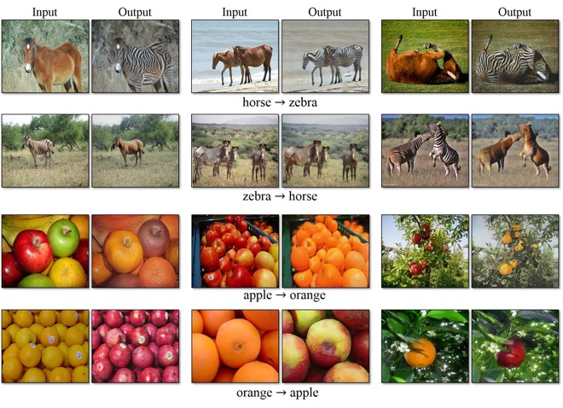
What’s in GluonCV
Generative Adversarial Networks (GAN)
CycleGAN

Slide 24
What’s in GluonCV
Distributed training
Take hours rather than days/weeks to train your own model on large datasets.

Slide 25
What’s in GluonCV
Deployment
Deploy your models to laptops, smartphones, IoT devices
Unleash the performance potentials

Slide 26

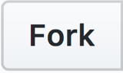

Like GluonCV?
https://github.com/dmlc/gluon-cv
https://gluon-cv.mxnet.io

